Slide 1




EVOASTRA VENTURES PVT LTD.
FACIAL RECOGNITION SYSTEM FOR SECURE EMPLOYEE IDENTIFICATION
AI-POWERED IDENTITY VERIFICATION USING DEEP LEARNING AND FACE EMBEDDINGS
MAJOR PROJECT 2 PRESENTAION
ABHISHEK GUPTA

Slide 2

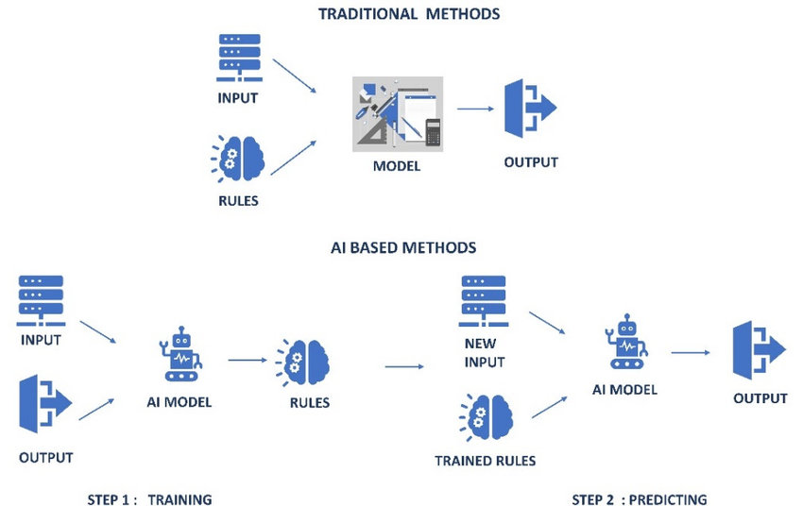
INTRODUCTION
WHY FACIAL RECOGNITION?
Growing need for secure digital identity verification
Manual verification is slow and error-prone
AI enables fast, scalable, and accurate identity checks
Applications: fintech, ed-tech, office access, KYC, etc.

Slide 3

PROBLEM STATEMENT
Identity theft and impersonation are increasing
Need to verify if a person’s face matches a known identity
System should work in real-time with high accuracy
Must handle variations in lighting, resolution, and expressions

Slide 4

DATASET
Dataset Used:
File: lfw_arnie_nonarnie.csv
Precomputed 128-D face embeddings (no images)
Classes: "arnold_schwarzenegger" vs others
Embeddings extracted from real images using models like Dlib or FaceNet

Slide 5

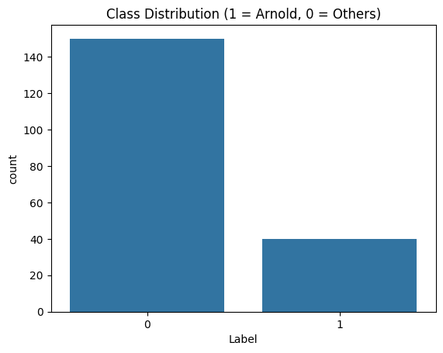
DATA PREPROCESSING
Label encoded: 1 for Arnold, 0 for others
Scaled features using StandardScaler
Train-test split (80/20)
Ensured clean, consistent data for model input

Slide 6

MODEL DEVELOPMENT
Deep Neural Network (Keras)
Input: 128 features
Layers:
Dense (128) + ReLU + Dropout
Dense (64) + ReLU + Dropout
Output: Sigmoid
Optimizer: Adam | Loss: Binary Crossentropy

Slide 7
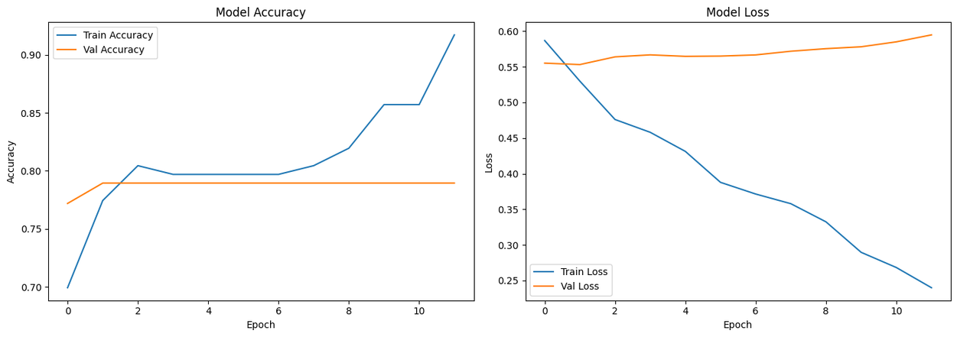

TRAINING & VALIDATION
Epochs: 50 (Early stopping applied)
Batch size: 32
Monitored accuracy and loss
Final test accuracy: 78.95%

Slide 8

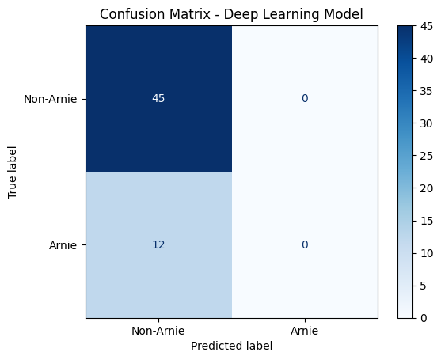
MODEL PERFORMANCE
Accuracy: 78.95%
Confusion matrix shows good class separation
Precision & Recall are acceptable for both classes
Room for improvement in edge cases

Slide 9

USER INTERFACE (PROTOTYPE)
Streamlit Web App (Prototype)
Upload image interface
Predict identity and display confidence
Easy for deployment in enterprise setting

Slide 10


ETHICAL & PRIVACY CONCERNS
Ethics & Privacy
GDPR & DPDP compliance
User consent before data usage
No surveillance or misuse
Data encryption & opt-out support

Slide 11
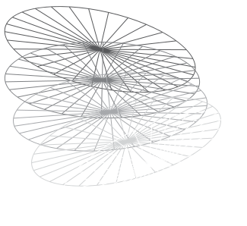
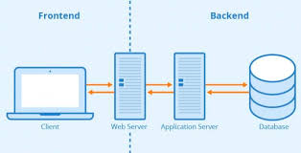
USER INTERFACE (PROTOTYPE)
Deployment Plan
Host model using Flask or Streamlit
Use Heroku, Render, or AWS EC2
Secure communication via HTTPS
Store embeddings securely in encrypted DB

Slide 12





FUTURE SCOPE
Real-time webcam capture with OpenCV
Liveness detection (eye blink, motion)
Multi-user classification
Use pretrained models (e.g., FaceNet, MobileNet)
Edge deployment (Raspberry Pi, mobile app)

Slide 13

CONCLUSION
Successfully built end-to-end facial verification system
Used embeddings + deep learning for accuracy
Achieved 78.95% accuracy
Ready for real-world use with further improvements

Slide 14
THANK YOU
Questions?
Let’s connect:
📧 Email
🔗 LinkedIn
🌐 Github

